Slide 1
PROVIDING DATA PRIVACY OF E- HEATHCARE DATA
BTech in Information Technology
PRESENTED BY
SUBHAJIT GHOSH Roll: 10000220058 Reg.:201000100220005
JOTIRMAY SIKDAR Roll:10000220060 Reg.:201000100220007
RAJIB KUMAR MAJUMDER Roll: 10000219024 Reg.: 030957
SAPTARSHI MONDAL Roll: 10000219074 Reg.: 043001
Guided By:
SAYANTANI SAHA
Department of Information Technology.
Maulana Abul Kalam Azad University Technology, West Bengal, India

Slide 2

Motivation
Health data is so sensitive data. Only legitimate users should get access to it. No other medical personnel should access the data without permission. So, data need to be protected with a proper cryptosystem. Now the traditional cryptosystem is not able to provide end-to-end security to the system. Encrypting each patient’s data with an encryption key and sharing the key with the user -- is a very common method to maintain security. However, this traditional approach is not very efficient. First, it is going to store a huge number of encryption, and decryption keys, and key sharing should be done in the proper way to secure the system. In case the user like a doctor or nurse or any other user is changed we need to re-encrypt the patient data with a new key. So the traditional approach is not found to be suitable. Moreover, the data revealed to the doctor, may not be required by the pharmacist or pathologist so we need to separate the patient data into smaller chunk and share it with the concerned user. For example, the pathologist need not access the data of medicine advice by the doctor or the pharmacist may not need the data of the pathological report. So here is the need to keep the data in an efficient data model system.

Slide 3
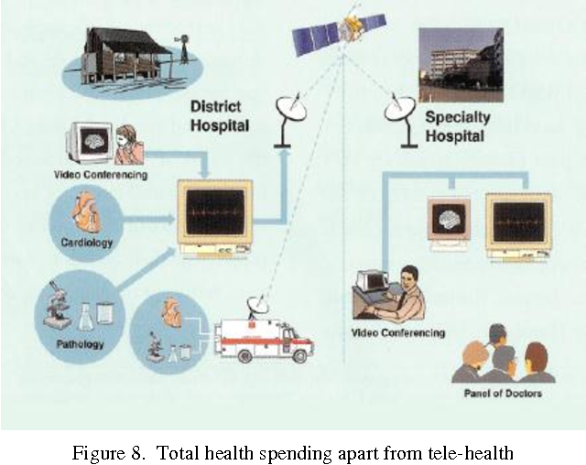
Literature Review
An Electronic Health Record (EHR) is a virtual platform that provides medical reports access to the EHRs and has the flexibility to supply information about patient care. Not only that the EHR demonstrated here to store and supply information for patients, but it also has an understanding of how data of the patient must be sent to users or staff of the HealthCare Center. This tool will also allow the patient to access their health data and give them better control over their health. The security part is an extensive part of this project, the security will be applied to the data which will be or are being sent to the different users or staff of the healthcare center. Currently, we are researching through the security of what type of security will be most appropriate and how to apply the security, and this is also the main challenge we are facing right now. The authors in paper [1] discussed the security challenges in the healthcare system.

Slide 4

PROPOSED METHOD:
To collect most of the information about hospitality and medical services.
• Patients are easily allocated to the doctors.
• Doctors, pharmacy, paramedical, and other medical staff search is possible and secured.

Slide 5
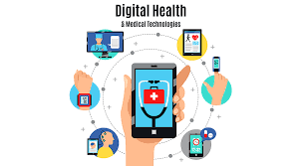
IN FUTURE
In future we will be using blockchain technical skills and cryptography for data privacy.As a example we say that if a paitent admit in a hospital for his dieases .There dr .and register admin have some question for him .and its recorded by authority . And its stotre a data base.and second one is the same paitent is admit another hospital for another disease .here the previous hospital does not share the information of the paitent with the second hospital.Here is information blockage and data corrupt.only the dr. ,admin and the paitent accees the data.the pharmachist will not access the data .he just access the prescription.only the paitent have the main acees to share the data with the another hospital.
NOW:
1.we use html for web page
2. CSS for web color and bootstrap for the overall design
3. MongoDB is used for a secured store of collection of unstructured data(NO SQL)

Slide 6
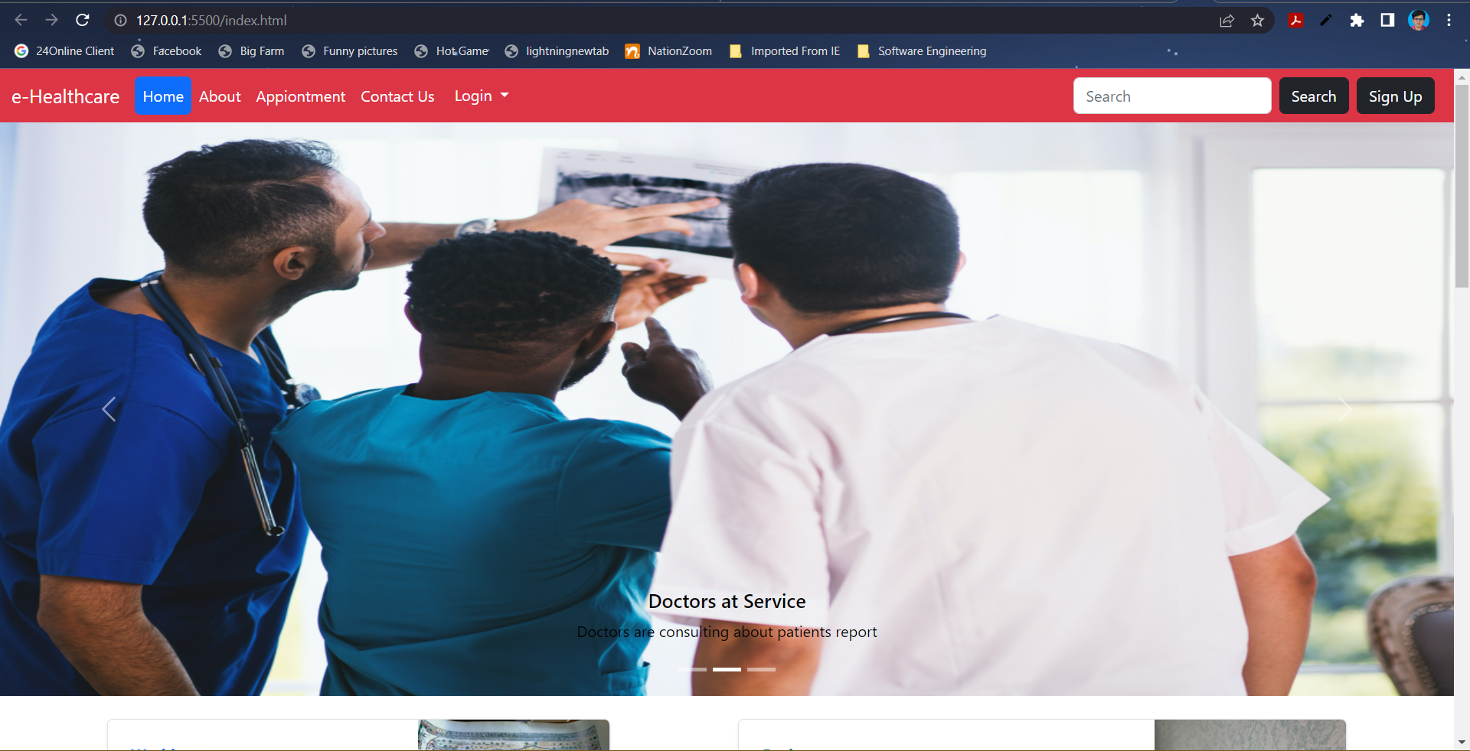

Slide 7
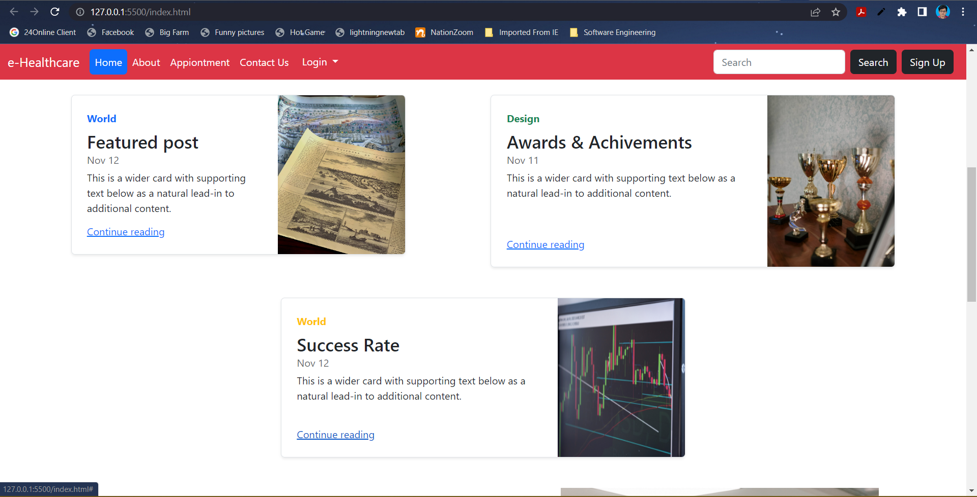

Slide 8
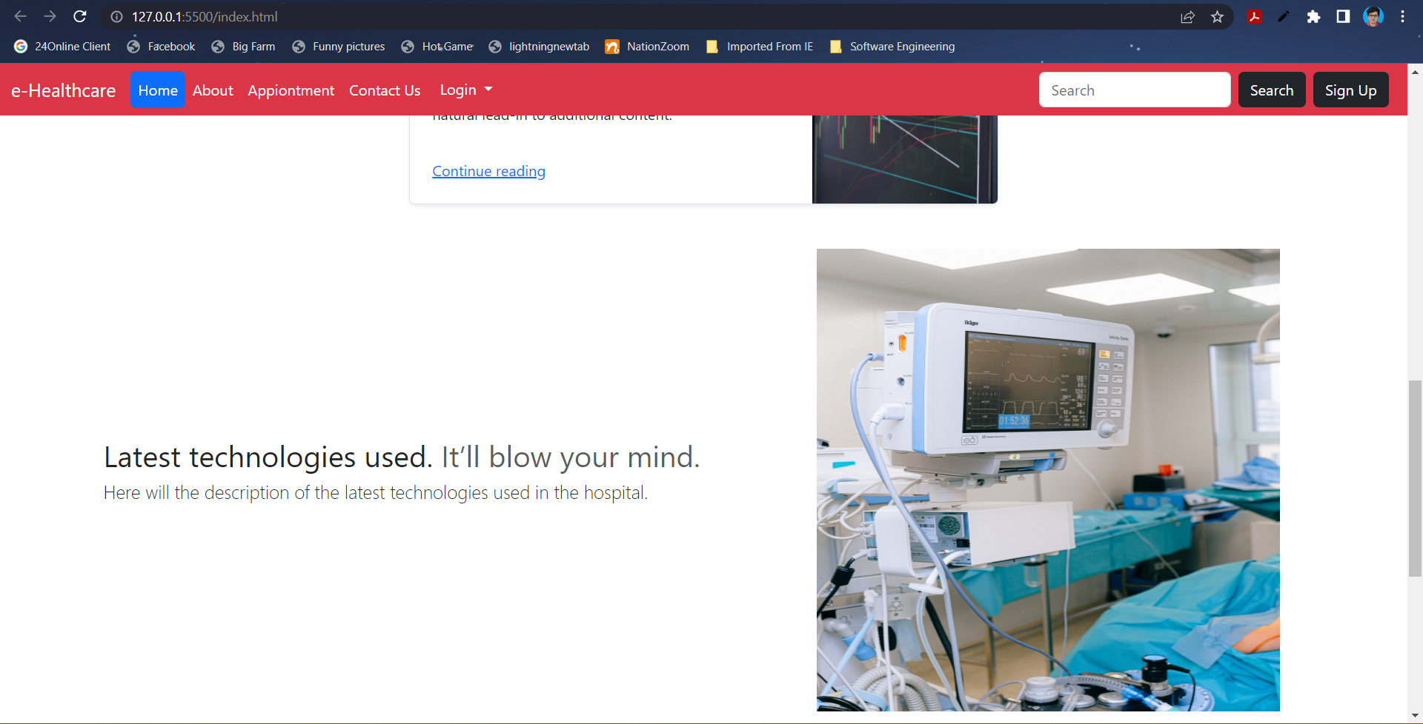

Slide 9
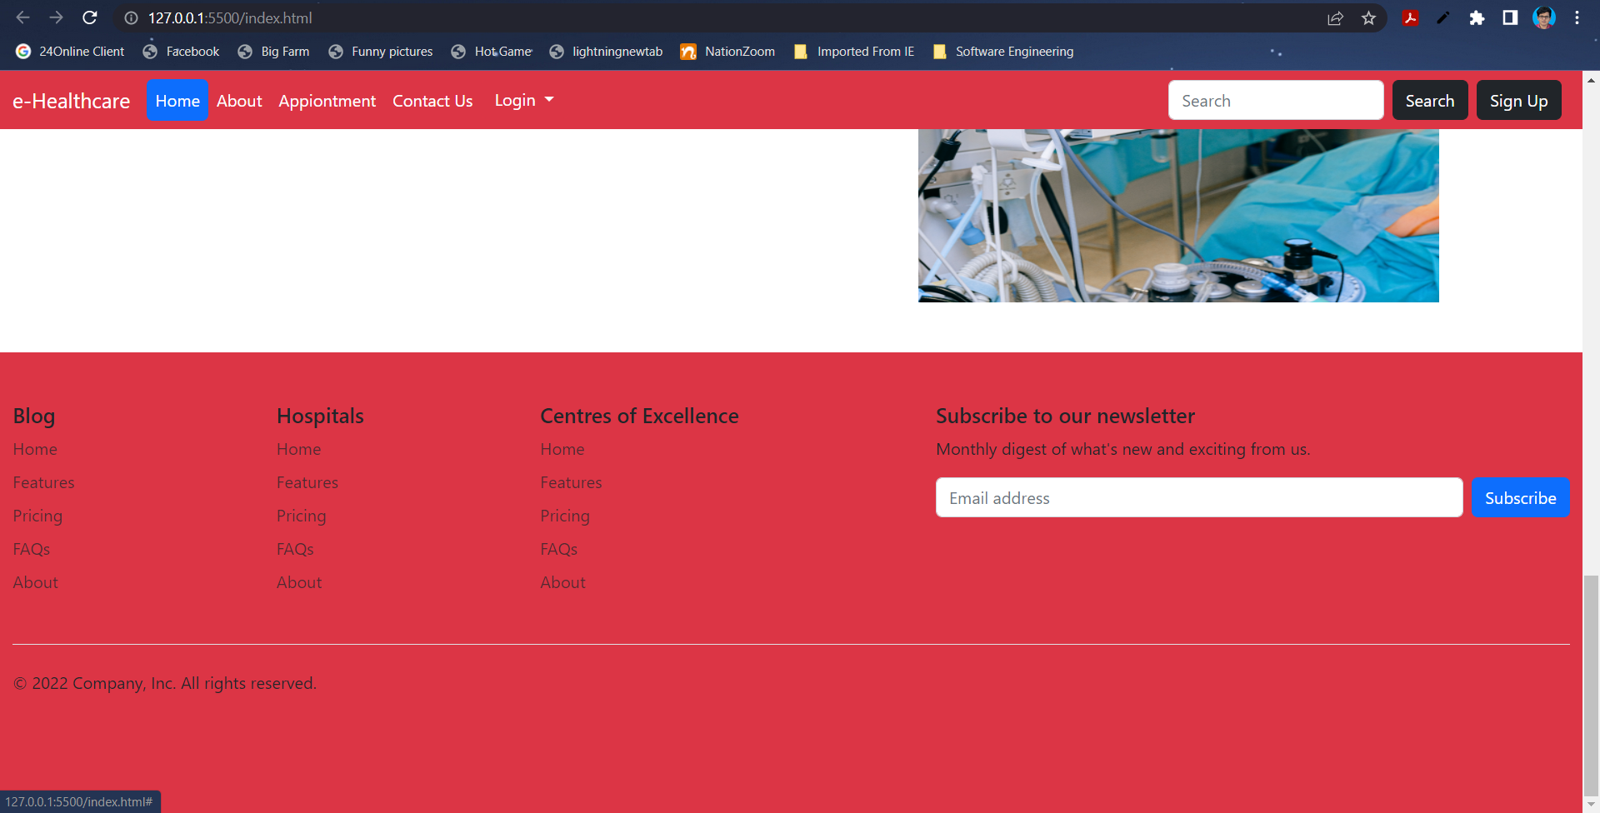

Slide 10
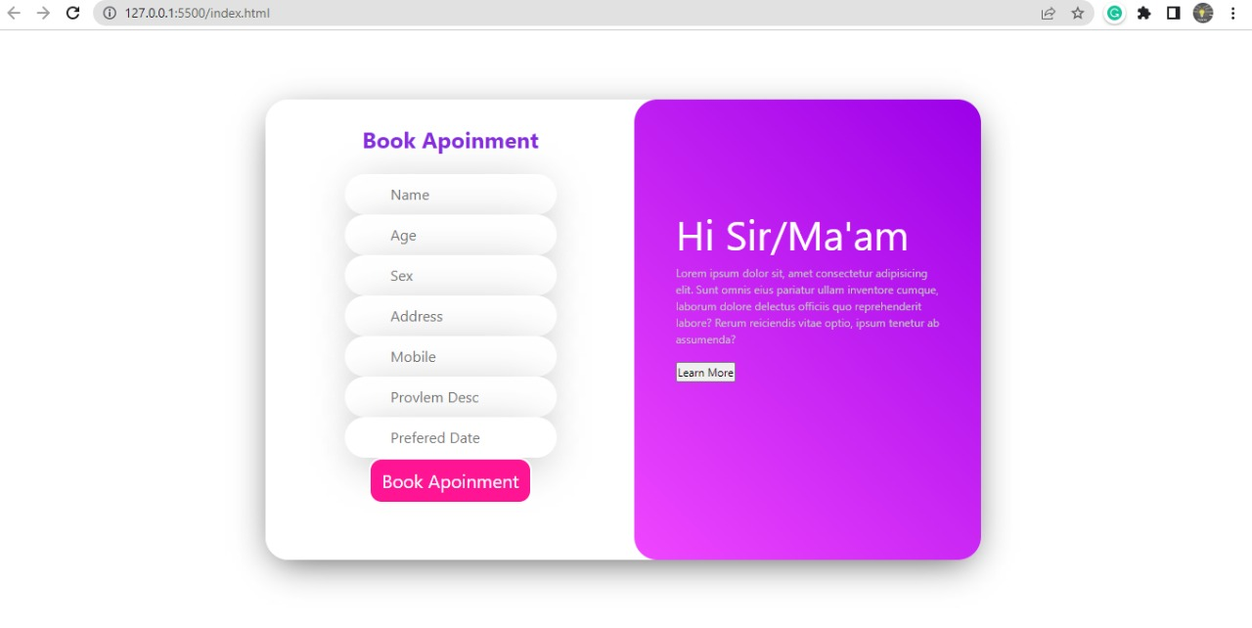
Experimental Results

Slide 11
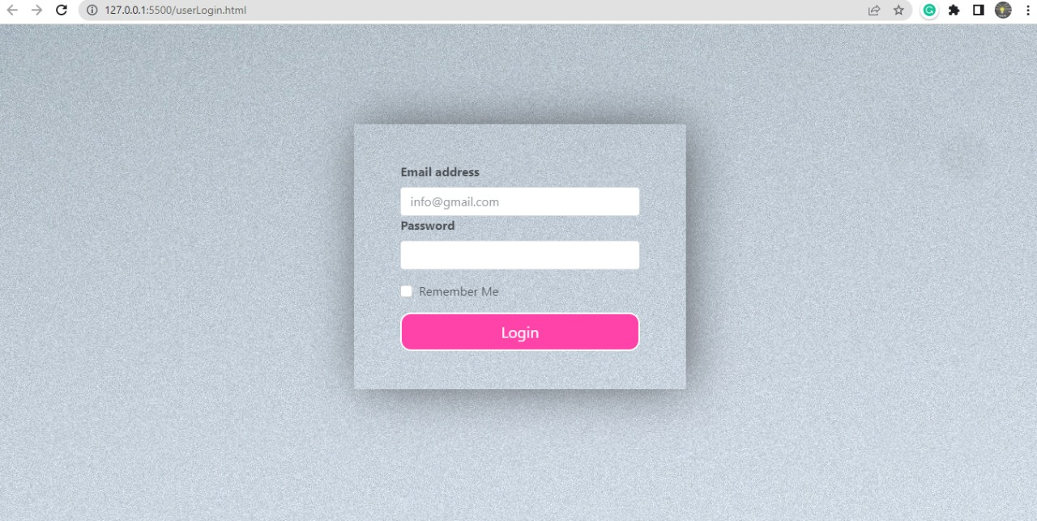

Slide 12
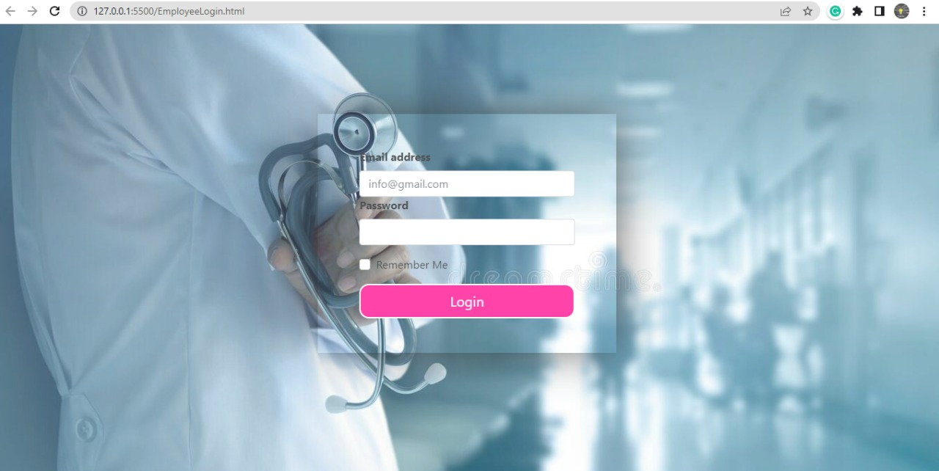

Slide 13
Now we are going to represent database tables which we have previously used for appointments, signup etc.

Slide 14
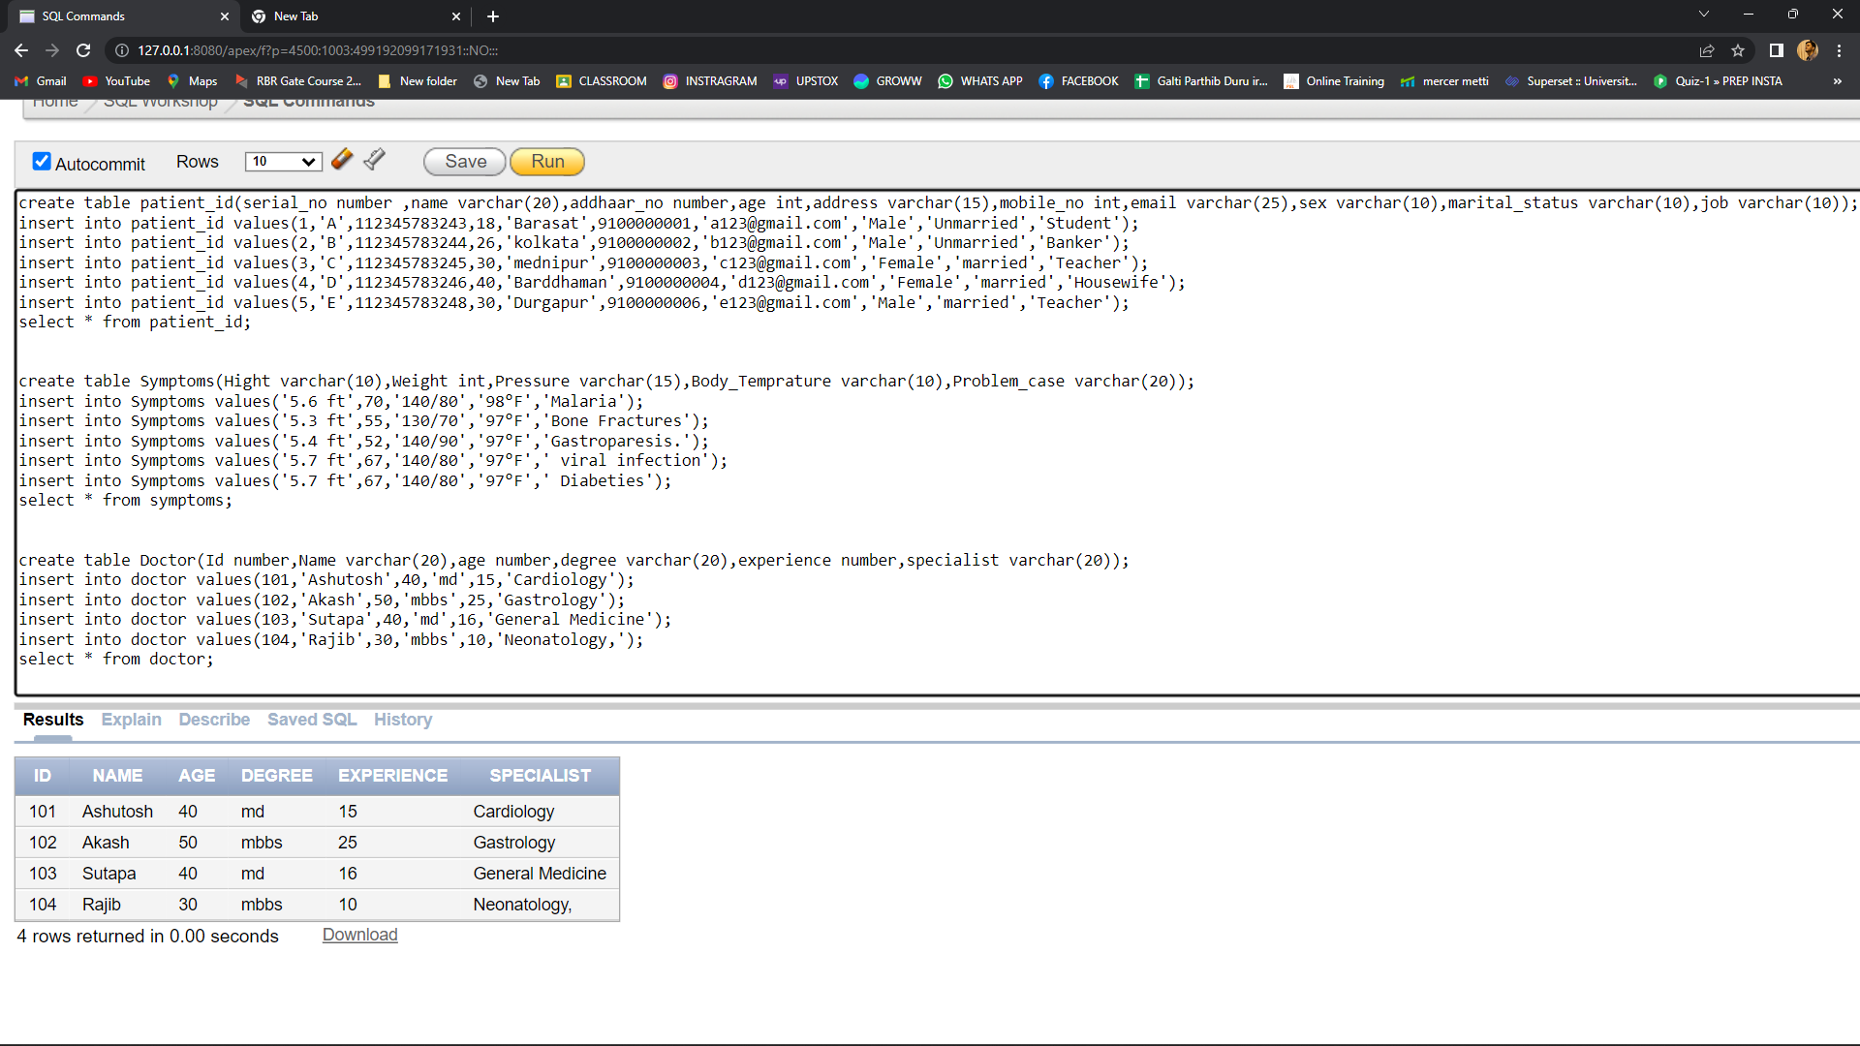
DOCTOR’S TABLE

Slide 15
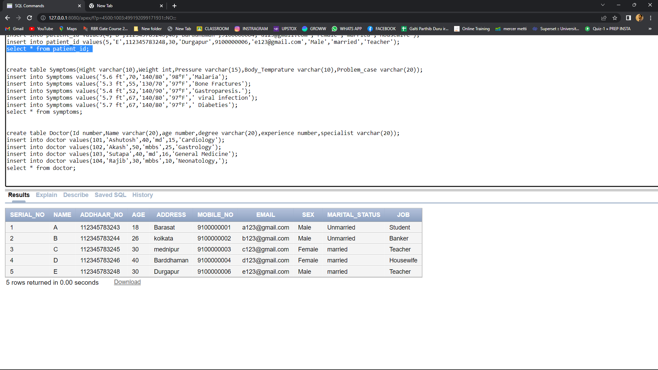
PATIENT’S TABLE

Slide 16
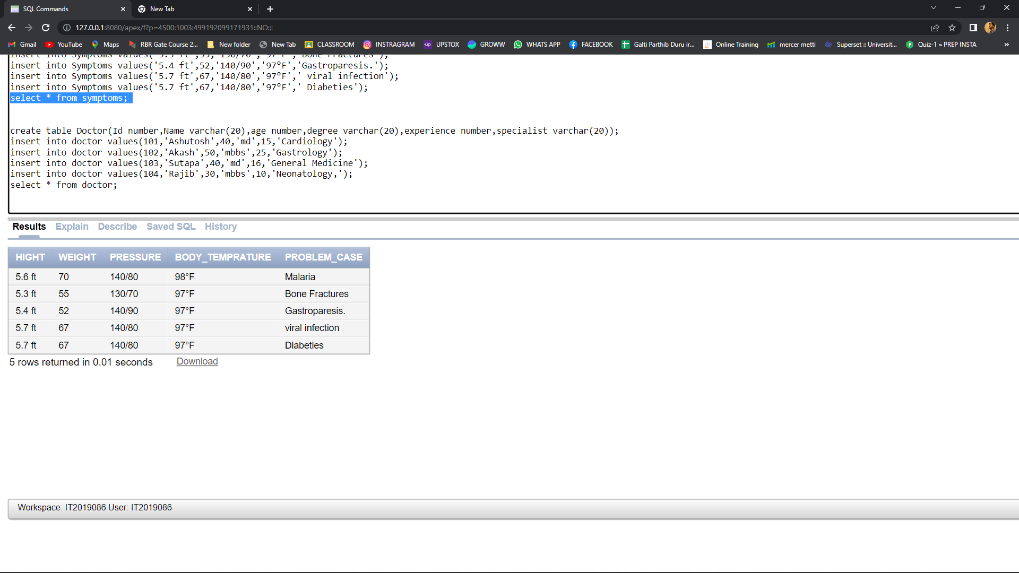
DISEASE’S TABLE

Slide 17
But we face some problems storing data in table format(MySQL). So, we used MongoDB for storing data in collection format….

Slide 18
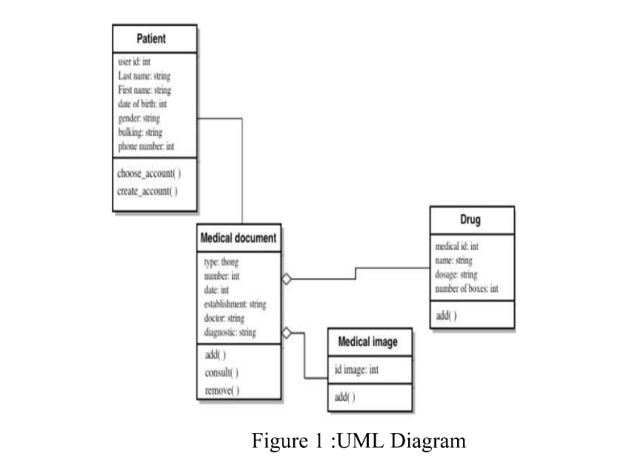

Slide 19
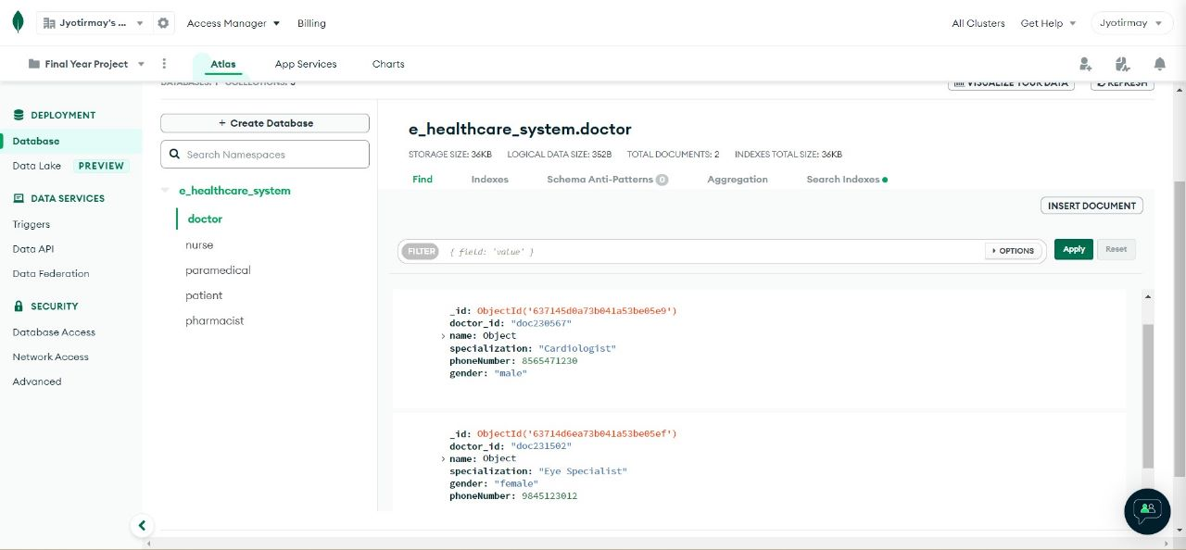

Slide 20
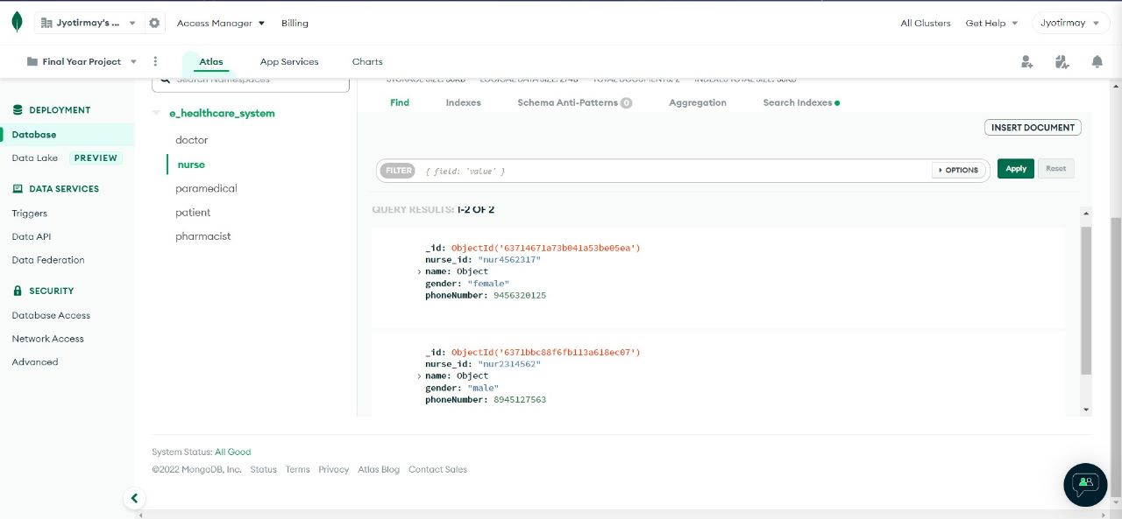

Slide 21
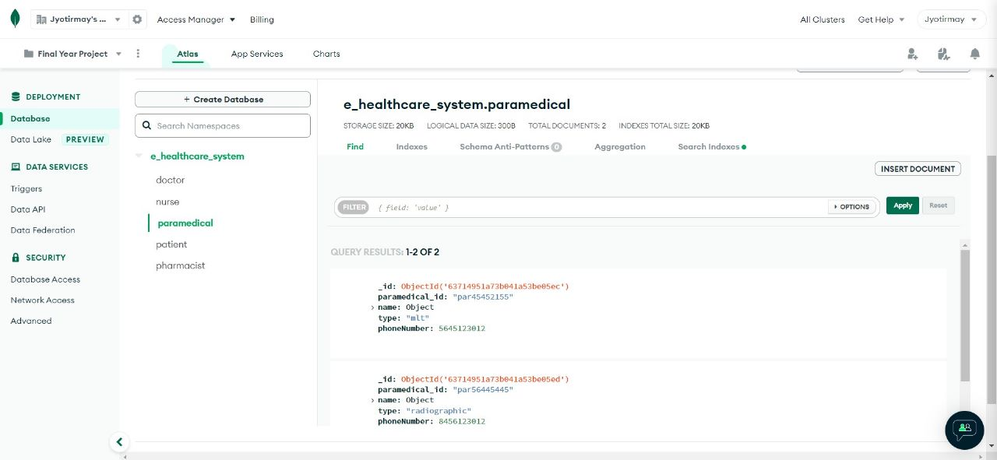

Slide 22
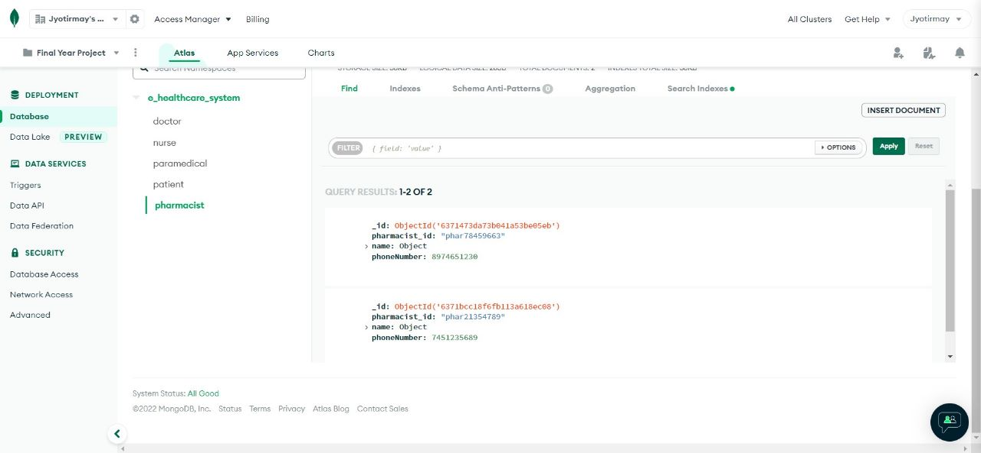

Slide 23
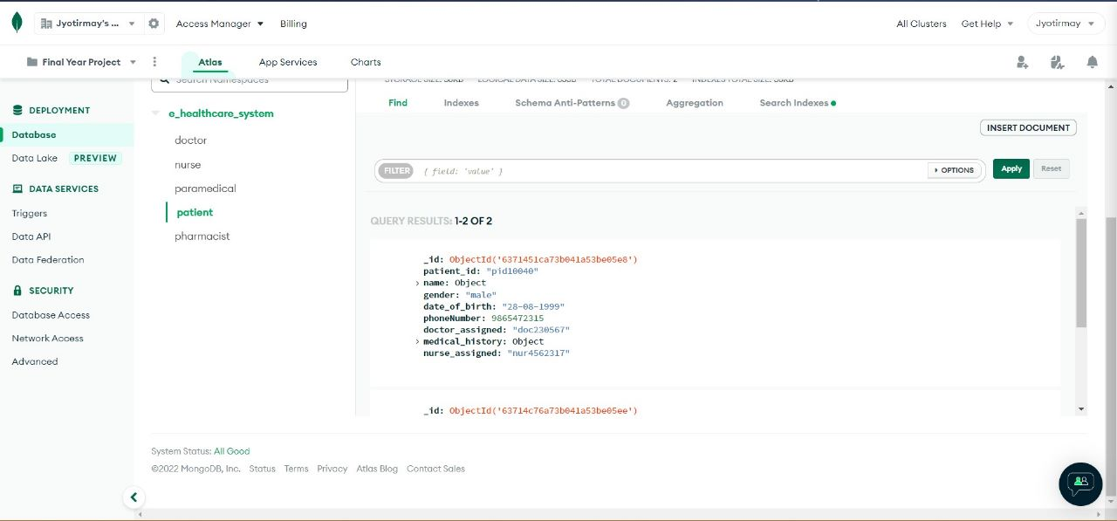

Slide 24
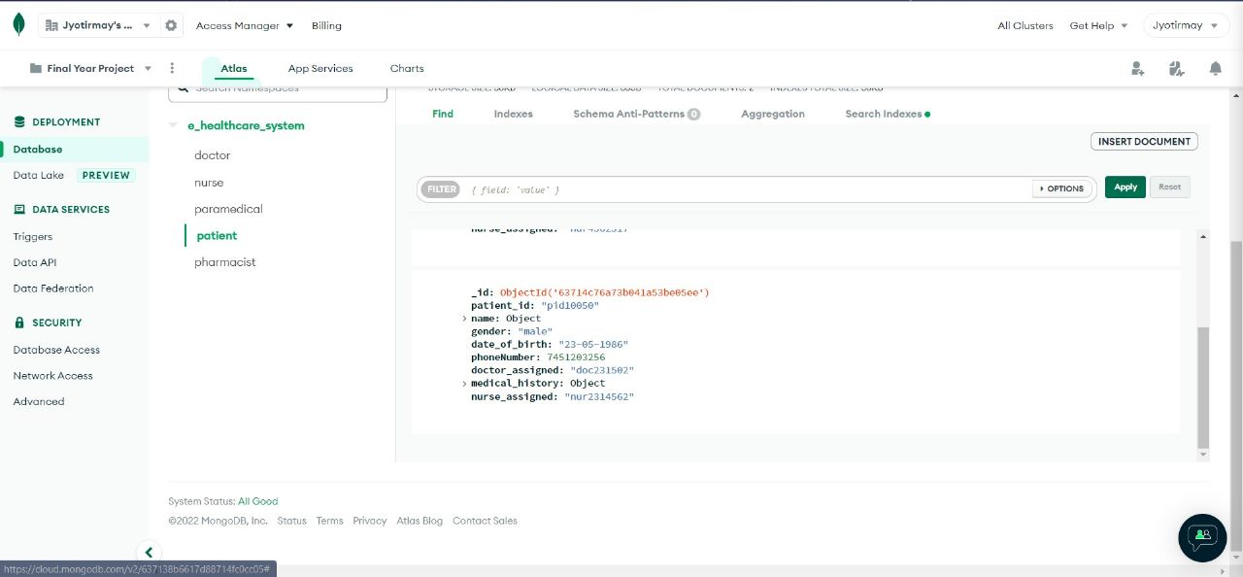

Slide 25
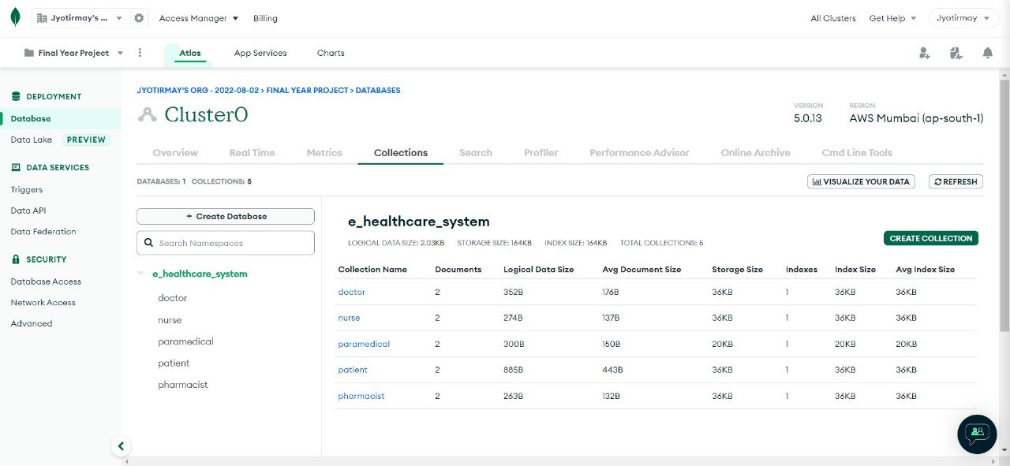

Slide 26
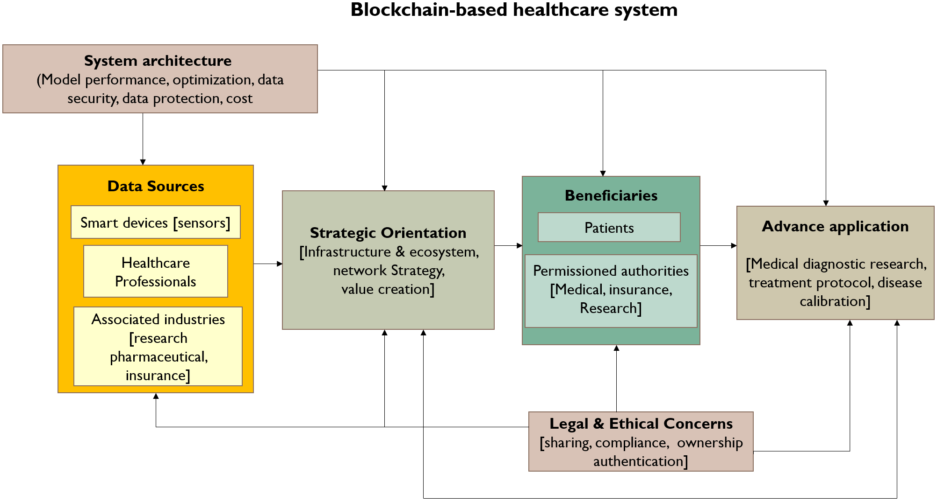
Algorithm
The user sign in with the basic details and make themselves an account. The communication between the users is done by this application. The practice of encrypting crucial data when sending data from one computer to another or keeping data on a computer is known as cryptography. Fernet is a block cipher mechanism that ensures the encrypted message cannot be altered or read without the key. The keys are encoded using URL safe encoding. Fernet also employs 128-bit AES in CBC mode with PKCS7 padding, with HMA Cauthentication based on SHA256. Python supplies a cryptography package that aids in the encryption and decryption of data. Using the encrypt and decrypt methods , the fernet module of the cryptography package offers built functions for generating the key, converting plaintext to ciphertext, and decrypting ciphertext back to plaintext.

Slide 27
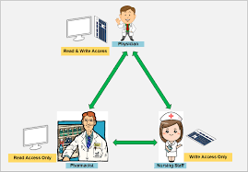
METHOD’S will BE USED
Generate_key(): A fresh fernet key is generated using this procedure. The key must be kept secure because it is required to decipher the ciphertext. The user will be unable to decrypt the communication if the key is lost.
Encrypt(data): A "Fernet token," or ciphertext, is the result of this encryption. When it was generated in plaintext, the encrypted token also included the current timestamp. If the data isn't in bytes, the encrypt procedure will fail. decrypt(token, ttl = None): The Fernet token given as a parameter is decrypted by this procedure. The original plaintext is returned if the decryption is successful ; otherwise, an exception is thrown. token (bytes), the Fernet token (ciphertext) is passed for decryption. The ‘ttl’ denotes the time about how long a token is valid . The following command is used to install the cryptography package: pip install cryptography ‘from cryptography . fernet import Fernet’ is used to import Fernet module from cryptography package.

Slide 28
Conclusion
The paper represents a system that was conceived to scale back the overload of the physicians within the hospital and to help them with the process of recording the observations within the patient clinical observation sheet.
The architecture offers a web-enabled framework that integrates with the activities of doctors, nurses, paramedical, patients, and pharmacists. Heath-care security should aim to enhance the quality of healthcare while cutting costs.
Our model aims at protecting health care from unauthorized user attacks. The research looks at the sophisticated multifaceted or authenticated health records that are secure in the system.

Slide 29
Reference:-
[1] “Enhanced Data Security in Cloud-base E-Health Care System” by Asha Bhadra S Kumar, Aswanthy N, Elizabeth K Jacob, Arya Binu, and Ms. Divya S B.
[2] https://www.diva-portal.org/smash/get/diva2:647835/fulltext01.pdf.
[3] D. A. Garwin. (1993) Building a Learning Organization. Harvard Business Review. 73-91. Available: https://hbr.org/1993/07/building-a-learning-organization.
[5] J. M. McGinnis, L. Stuckhardt, R. Saunders, and M. Smith, the Best care at lower cost: the path to continuously learning health care in America. National Academies Press, 2013.
[6] J. Enticott, A. Johnson, and H. Teede, “Learning health systems using data to drive healthcare improvement and impact: a systematic review,” BMC health services research, vol. 21, no. 1, pp. 1-16, 2021. [Online]. Available: https://bmchealthservres.biomedcentral.com/articles/10.1186/s12913-021-06215-8#Tab3.
[7] T. Foley and F. Fairmichael. “Professor Charles Friedman Interview.” The Learning Healthcare Project. https://www.learninghealthcareproject.org/section/evidence/25/50/professor-charles-friedman-%20interview
[8] The University of Michigan. “Revolutionizing Learning, Transforming Health.” The University of Michigan. https://medicine.umich.edu/dept/learning-health-sciences
[9] MCBK. “Annual MCBK Public Meeting.” MCBK. https://mobilizecbk.med.umich.edu/news-events/annual-meetings
[10] MCBK. “Featured Events.” Mobilizing Computable Biomedical Knowledge (MCBK). https://mobilizecbk.med.umich.edu/news-events

Slide 30
THANK YOU

